Slide 1
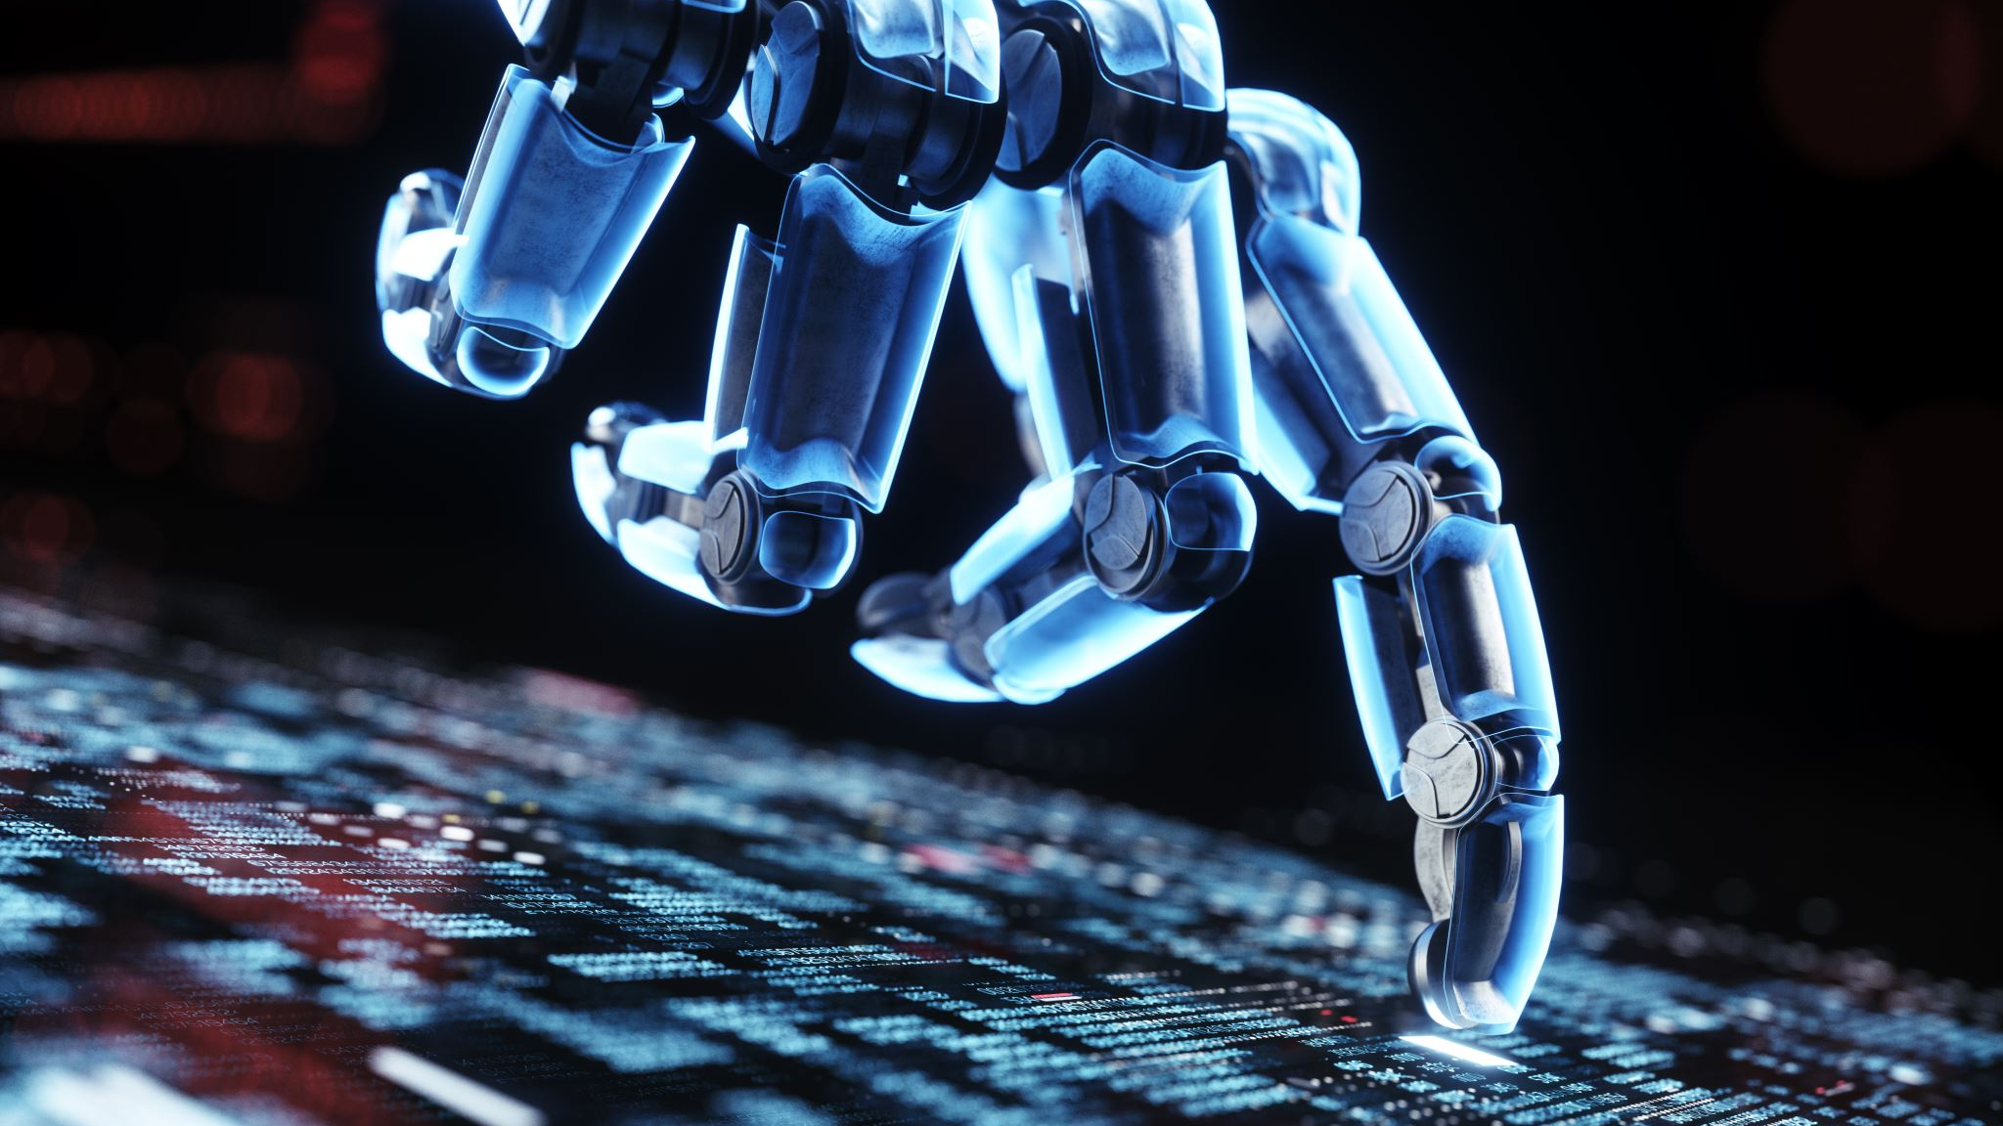
WRO Self-Driving Robot
Presented by: Ameer Abdullah Masmali and Khallad Madkhali

Slide 2

The Issue In Real-Time
Robots today have some serious issues that can and need to be solved.
Human Error and Safety
Human error is a leading cause to accidents on the road. With self-driving cars, we aim to reduce accidents significantly by minimizing or eliminating the role of human drivers.
Environmental Impact
Cars have always given off pollution. Self-driving cars have the potential to reduce greenhouse gas emissions by reducing traffic congestion, optimizing driving patterns, and promoting the adoption of electric and alternative fuel vehicles.

Slide 3
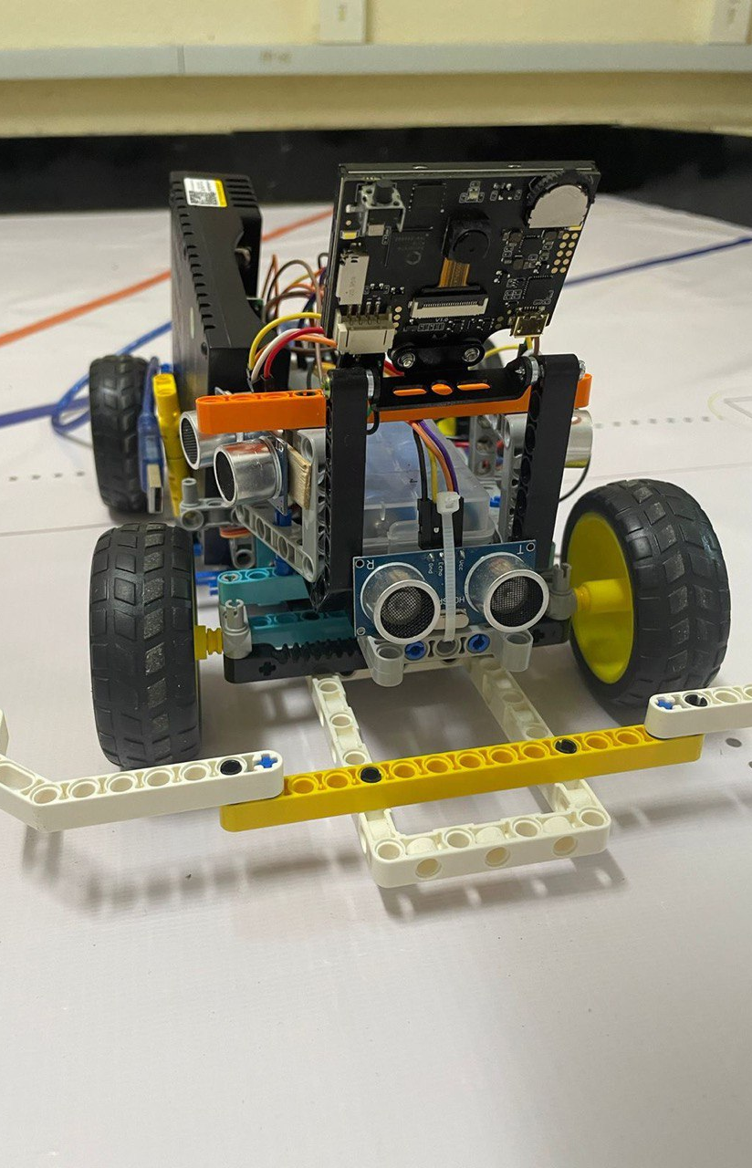
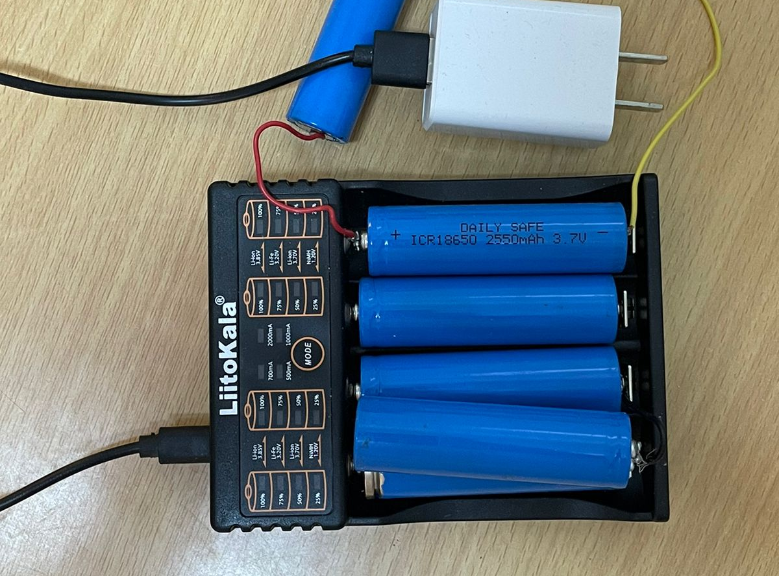
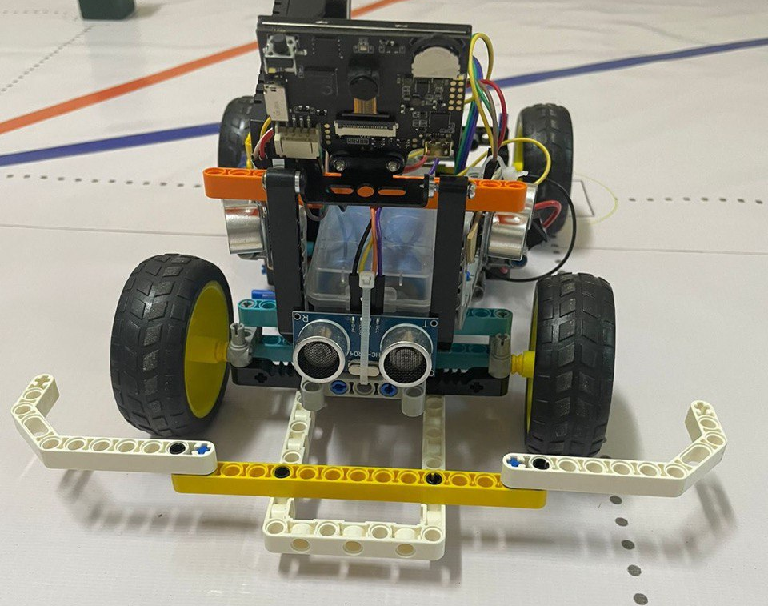
Our Mission
As students, we envision our self-driving robot to as perfect as possible. For this, we have key goals for our robot.
Safe Operation
The mission of a self-driving robot is to operate safely and the risk of accidents or collisions
Efficient Navigation
Self-driving cars aim to navigate efficiently from one location to another.

Slide 4

How It Works
Our robot is a self-driving car. The robot is powered by AI using HuskyLens. We’re using color recognition so that the robot can detect the green, red and blue blocks scattered around the map.

Slide 5
The Lens
We have three different colors that the lens detects. The colors consist of blue, red, and green. The blue color is a blue line on the track. The red and green colors are blocks on the track that are used as obstacles to indicate where the robot needs to go. The HuskyLens is a camera sensor that helps the robot find its destination using the blocks and line. Each block has a different role for the HuskyLens camera sensor.
Blue line: The robot uses this block to count each lap that it completes.
Red block: The red block indicates the robot to turn and move right.
Green block: The green block indicates the robot to turn and move left.

Slide 6
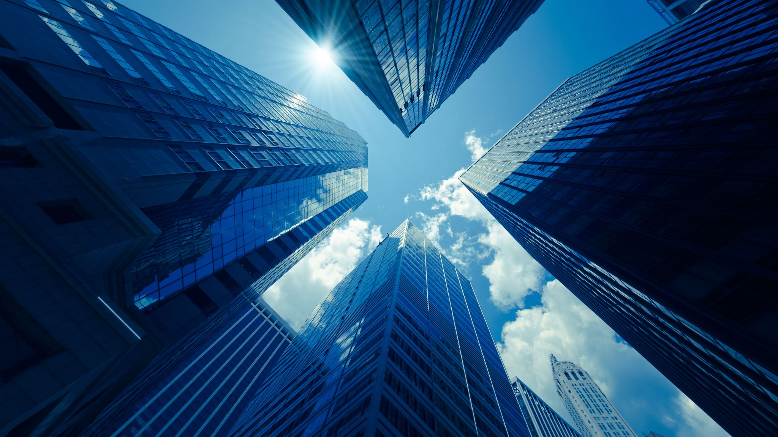
Effect On The World
Our project can improve and the future of the way we do things. With the first small steps into this vision, we believe our project can simplify jobs and execute tasks without error.

Slide 7
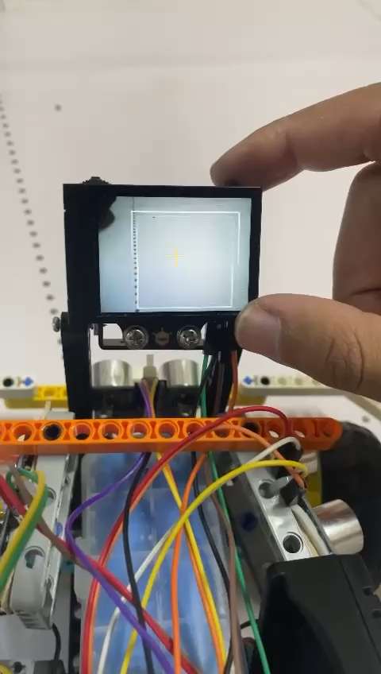
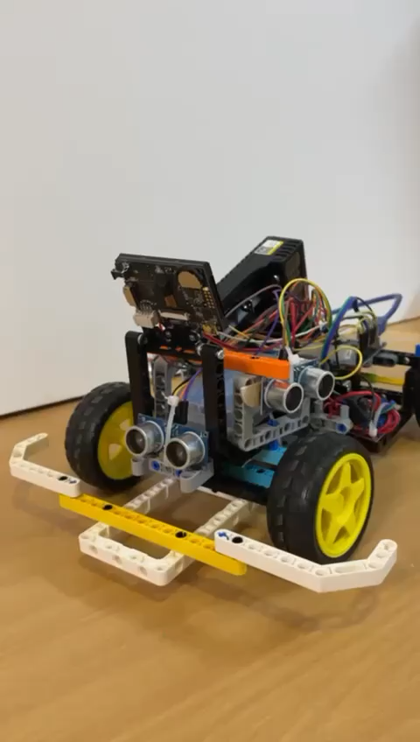
Short Videos

Slide 8
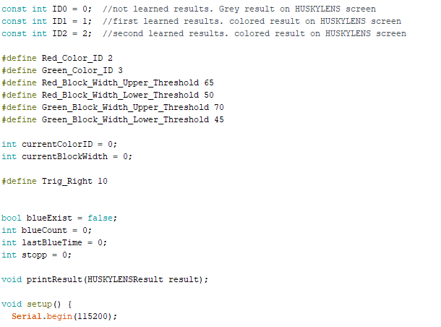
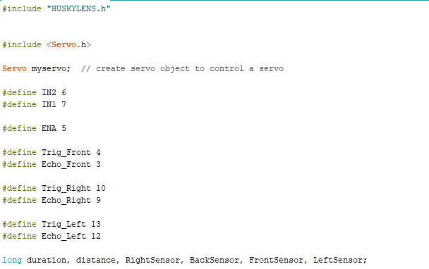
The Algorithm
In this part, we are working to install libraries for the code. First HuskyLens library and then Servo motors. There is a pin connection between motors, ultrasonic sensors, HuskyLens, motor driver, and the controller board Arduino Uno.
In this part, we are using artificial intelligence to train the model using the HuskyLens camera, to train the camera to learn and differentiate the colors.

Slide 9
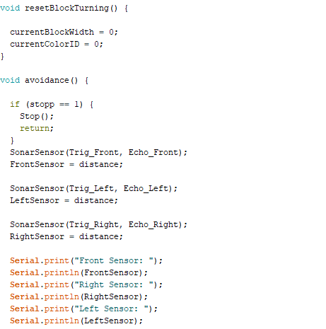
Void Function
The obstacle avoidance function is what we use to prevent the robot from accidents.

Slide 10
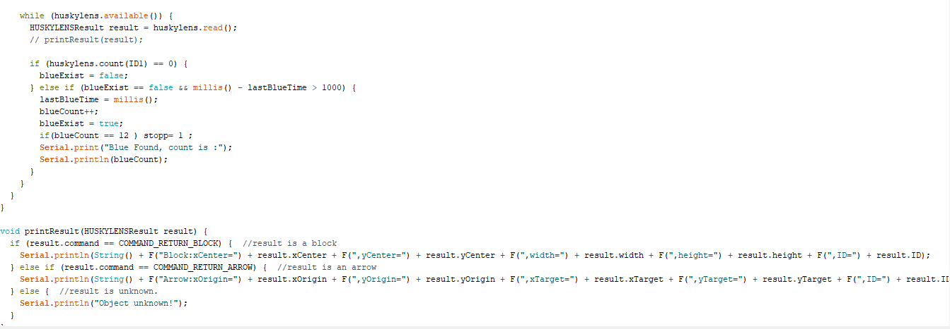
Lab Function
In the first lap, the Robot takes three laps around the track for each round. It follows the right wall, and for each round it counts four blue lines to complete a lap. So in total, the robot counts twelve blue lines for three laps in the first round.
In the second round, the concept will be similar to the first round. We will add red and green blocks to the track. The robot will start on the right side of the track. While completing three laps, the robot will use the HuskyLens camera sensor to detect and identify the red and green blocks using color recognition depending on AI. The red blocks indicate the robot to go right, and the green blocks indicate the robot to go left.

Slide 11
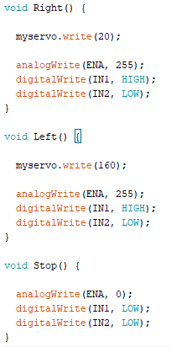
Servo Motor Code
This code lets the servo motor turn right or left depending on the distance. We need this so that the robot can dodge the red and green blocks and continue its path.

